Slide 1
Exam Comments
3:00pm-5:00pm Room SB111 on 11/14/19
Closed book, closed notes, no cell phone, no calculator
Allow to bring a 4’’x6’’ “cheat card”
Anything on the card MUST HAND WRITING
All lectures included on the test
Focus on things taught in class (lecture notes, in-class discussions, homework, programming assignment)
Exam structure:
Short answer questions
`big’ questions
Programming design related questions
Performance analysis/evaluation questions
Good luck!

Slide 2
Highlight
General concepts
Architecture, dependence, etc.
Algorithms
Parallelism and analysis
Performance
Speedup, scalability
Memory performance
Hierarchy and C-AMAT
I/O and file systems
PFS and HDFS
Communication
Programming
Notes:
, …

Slide 3
Career and Viewpoint A Random Walk
Xian-He Sun
Illinois Institute of Technology
Chicago, Illinois
sun@iit.edu
Notes:
This talk is on the scalability of multicore architecture.
The “scalability” refers to the capability of a system how well it can maintain the performance at a large-scale size compared to a small-scale size. A quick example: plain text file v.s. database solution for storing contact information with tens of thousands scale. In this talk, the “scalability” discussion is in the context of machine architecture.
--

Slide 4






The Surge of Cloud & Big Data
Mimic the electrical power grid
Higher Quality of Service
Increased
Efficiency
Increased Productivity
Reduced Complexity
& Cost
Improved Resiliency

Slide 5
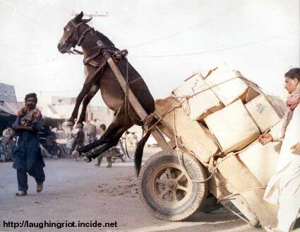
An Unbalanced System
I/O, Memory, Cache
CPU
Source: Bob Colwell keynote ISCA’29 2002 http://systems.cs.colorado.edu/ISCA2002/Colwell-ISCA-KEYNOTE-2002-final.ppt

Slide 6
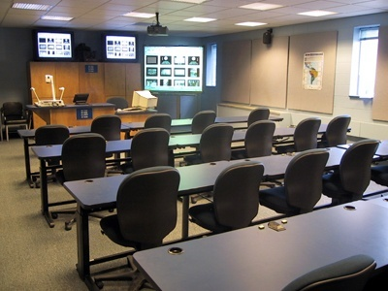


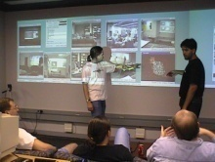



The View of Future Computing
Human-centered
They are connected to form `smart space’
Devices become smaller and powerful
Cloud link `smart spaces’ to support `global smartness’
A device is an entry of the cyber world

Slide 7
How did you get C-AMAT? From Memory-bound
1-f
f
Tacit assumption in Amdahl’s law
The problem size is fixed
The speedup emphasizes time reduction
Gustafson’s Law, 1988
Fixed-time speedup model
Sun and Ni’s law, 1990
Memory-bounded speedup model
Work: 1
1-f
f*n
Work: (1-f)+nf
X.-H. Sun, and L. Ni, “Another View of Parallel Speedup,” Proc. of IEEE Supercomputing'90, NY, NY, Nov.12--Nov.16, 1990.
Notes:
What view changed the industries to move into large-scale manufacturing? Scalable computing.

Slide 8
Conclusion
The technical foundation of next IT boom (computing & data processing) is emerging
It may need the change of computing infrastructure and concept, and may start slow
We have made fundamental contributions to new computing infrastructure
Key: Find your position and persistent
http://www.cs.iit.edu/~scs/sun/

Slide 9
After Conclusion: Research and Career Development
Goal
Preparation
Management and Leadership
Role Change
Direction

Slide 10

Position of the Starting Point
The Difference of Education
Thinker
University of Chicago
Harvard University
Technical Leader
Illinois Institute of Technology (IIT)
University of Illinois at Urbana-Champaign
Good Citizen
College of DuPage
Community Colleges

Slide 11

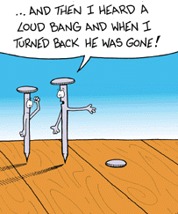
Career：Preparation
Approach
Build strong muscle
Build Strong Hammer (skill)
Find nails
Muscle
General education
Hammer
Skill
Find the nail
Stand out
Apply you hammer and get job done

Slide 12
Career：Preparation
Muscle
Ability to learn and improve on your own
（Undergraduate）
Hammer
What can you offer
（Specialty）
Find the nail
Find the match
Approach
Jumping pad
Find your niche, build your resume
Cumulate and Burst

Slide 13
Conduct Research (Solve a Problem)
Approach
Build Strong Hammer (skill)
Find nails
Find the nail (topic)
Select appropriate hammer
Comprehensive analysis
Stochastic/Statistics
Data Mining/Machine Learning
Simulation

Slide 14
Career：Find a Job
Our Practice
Match
Strong record
Stand out
Phone Interview
First screening
Onsite Interview
Technical
Personality
Offer
Reason behind the surface
Approach
Do your homework
Polish your presentation
Be yourself

Slide 15
Role Change （转型）
Career：Development
Advance with time
Student
Skill, build the hammer
Assistant Professor (junior engineer)
Nail and hammer
Associate Professor (senior engineer)
Supervise students
Professor (team leader)
Academic Leadership
Chair (manager)
Management and Academic Leadership

Slide 16
Role Change （转型）
事业：发展
Warning (提示）
Identify your role
Do what you suppose to do
Work step by step
The worst is you think you are better than everyone else
Student
Skill, build the hammer
Assistant Professor
Nail and hammer
Associate Professor
Supervise students
Professor
Academic Leadership
Chair
Management and Academic Leadership

Slide 17
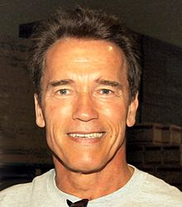



转型成功案例
Arnold Schwarzenegger

Slide 18



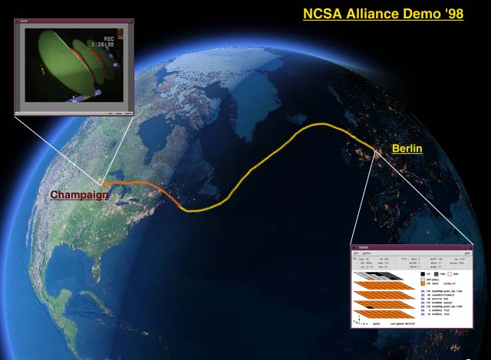
The Success of Grid Technology

Slide 19
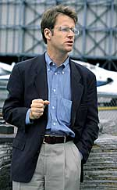
The Grid Success
Why is Grid?
Technology Driven
National infrastructure
Profits are reachable
Why is his development?
Toolkits
Security (GSI), Resource Management (GRAM), Information Services (GRIP), Data Transfer (GridFTP)
Who is the
handsome man?

Slide 20
The Grid Success
Why is him?
Infrastructure
Application driven
Physics applications
More development than academic like to handle
Less profit than industry to interest
Good team, strategy and deliverable
Leadership
Ian Forster
Argonne Laboratory

Slide 21
The Success Story
Why is him?
Identify topic
Define strategy
Position yourself
Version, collaboration and deliverable
NU-C
NU-E
UIC
Star Tap
ANL
IIT
Uof C
NCSA/UIUC
I-WIRE
OMNI

Slide 22
Comments
What have Learned?
Motivation
Search for new breakthrough
Enjoy your work
Beyond research data
What We Should Do?
As an individual
As a community

Slide 23
Position Yourself（定位）
Research in Different Environments
Academic
Basic research, prototype development
Ten years or longer
National Research Laboratories
Basic research, prototype/infrastructure development
High-risk, high-return
5 years or longer
Industry Research Laboratories
Basic research, prototype/full system development
One-three years

Slide 24
Thank you! To visit http://www.cs.iit.edu/~scs

Slide 25
Exam Comments
3:00pm-5:00pm Room SB111 on 11/14/19
Closed book, closed notes, no cell phone, no calculator
Allow to bring a 4’’x6’’ “cheat card”
Anything on the card MUST HAND WRITING
All lectures included on the test
Focus on things taught in class (lecture notes, in-class discussions, homework, programming assignment)
Exam structure:
Short answer questions
`big’ questions
Programming design related questions
Performance analysis/evaluation questions
Good luck!

